Slide 1

Ellesmere Primary School

Slide 2
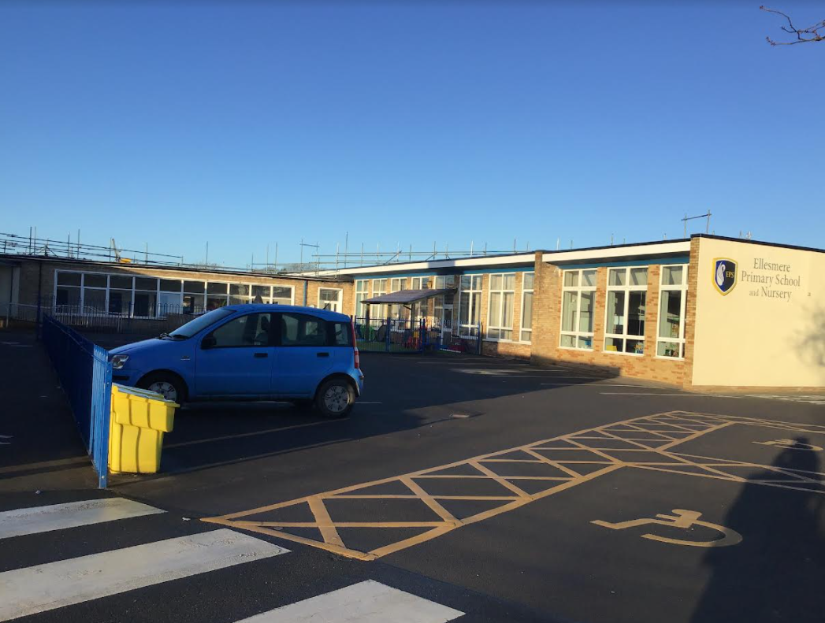
This is our school. We are currently having some building work done.
école

Slide 3
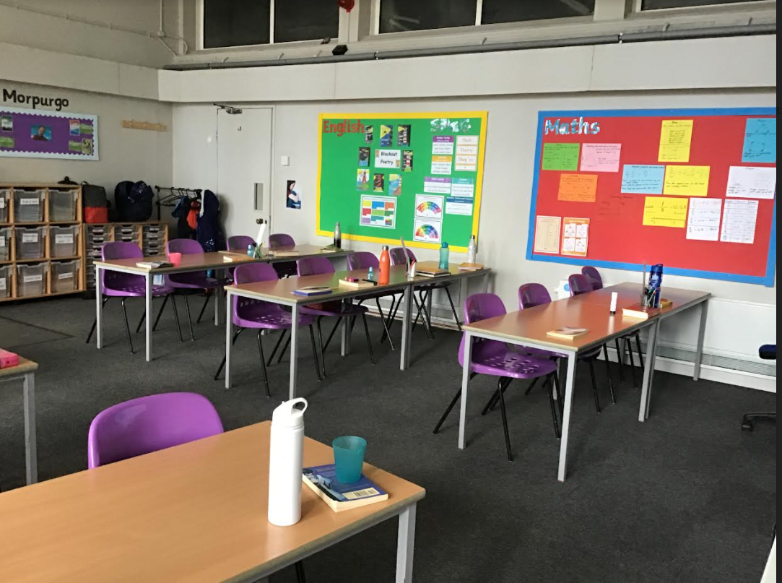
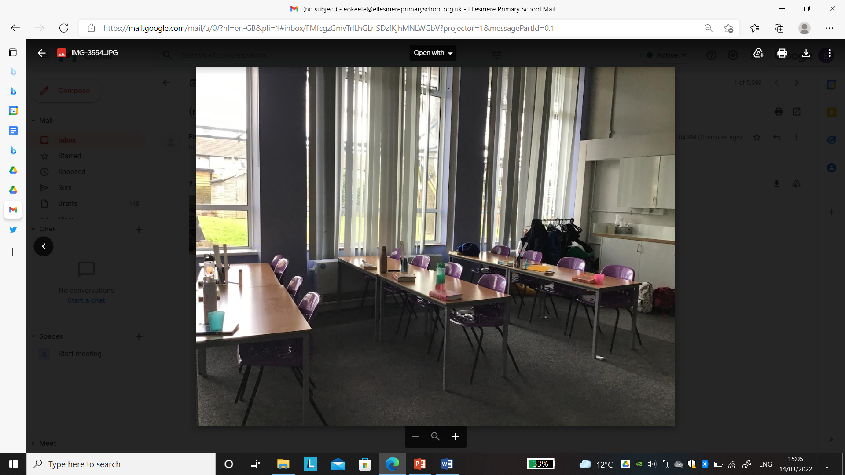
salle de classe

Slide 4
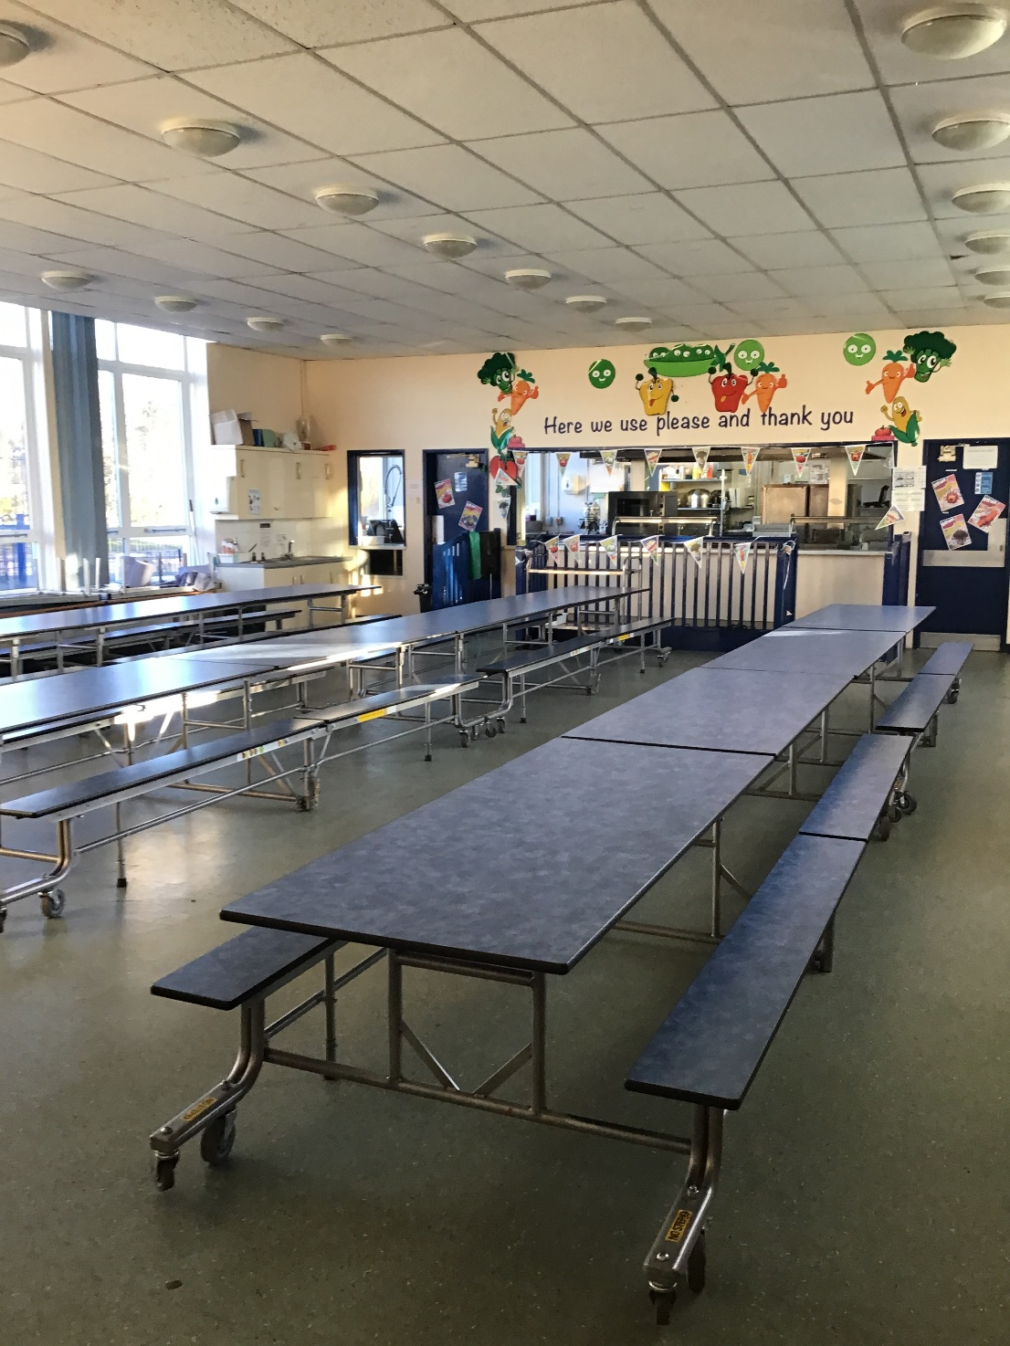
Cantine

Slide 5
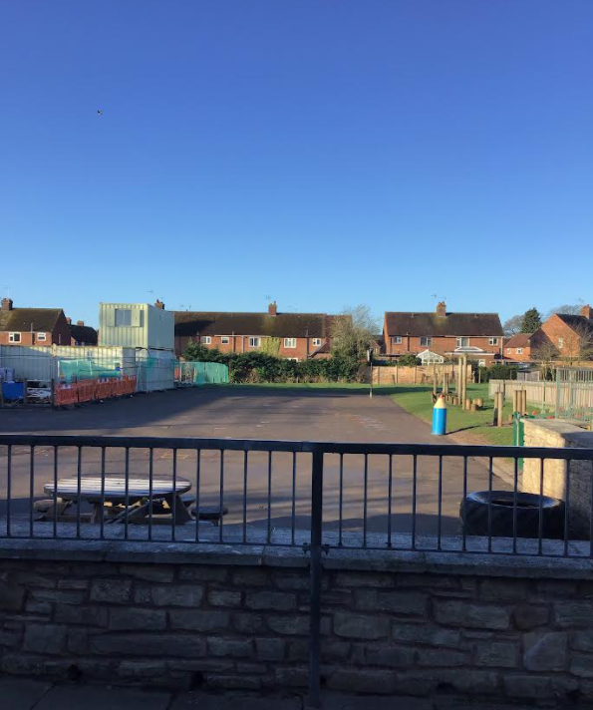
terrain de jeu

Slide 6
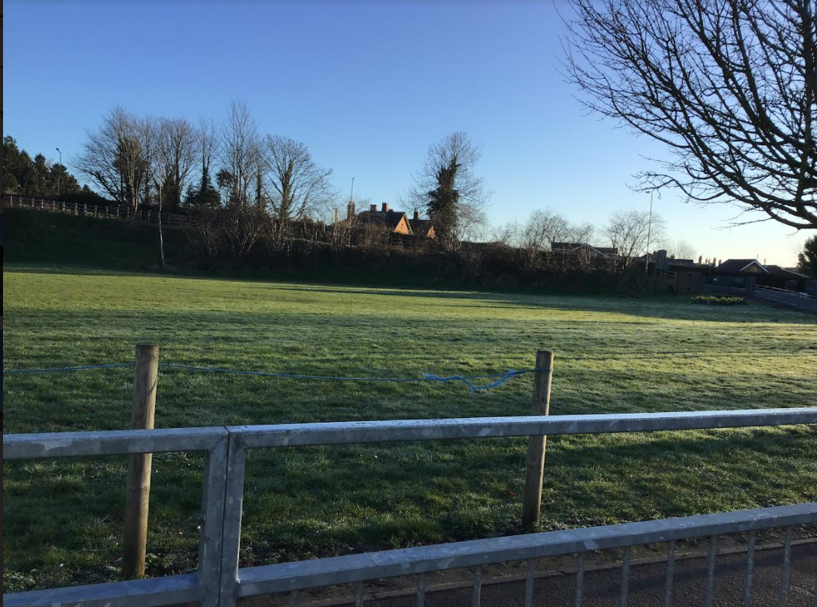
domaine scolaire

Slide 7
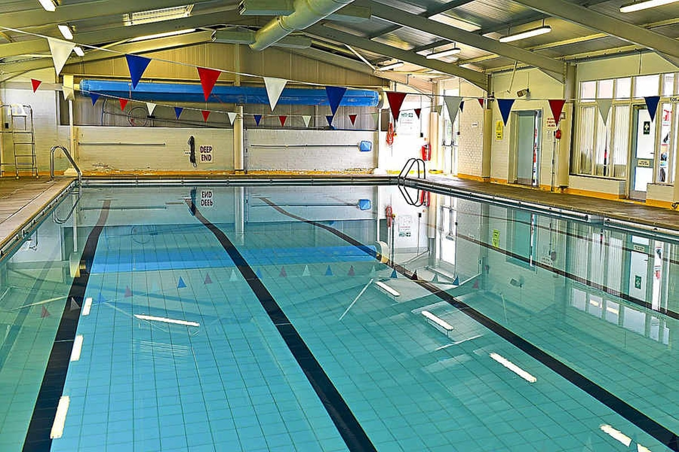
We have our own swimming pool. We have lessons once a week.
Piscine

Slide 8
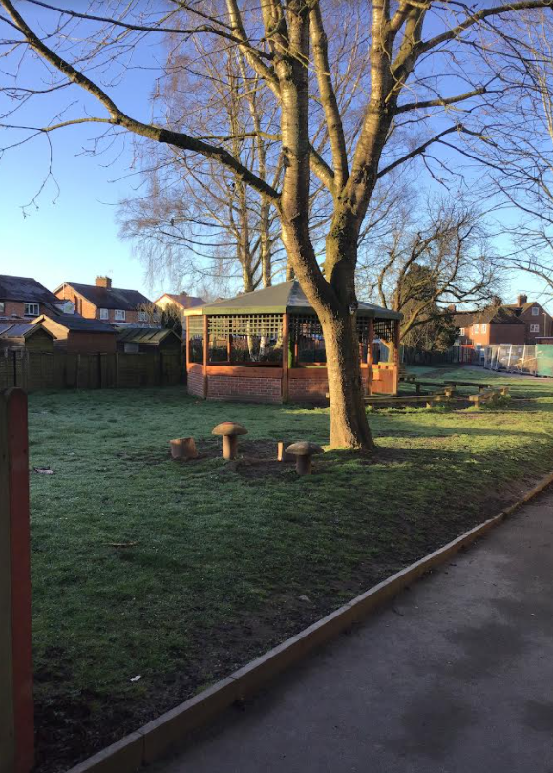

Slide 9
